Slide 1
Landlord Package Launch

Slide 2
Quotes Applications

Slide 3
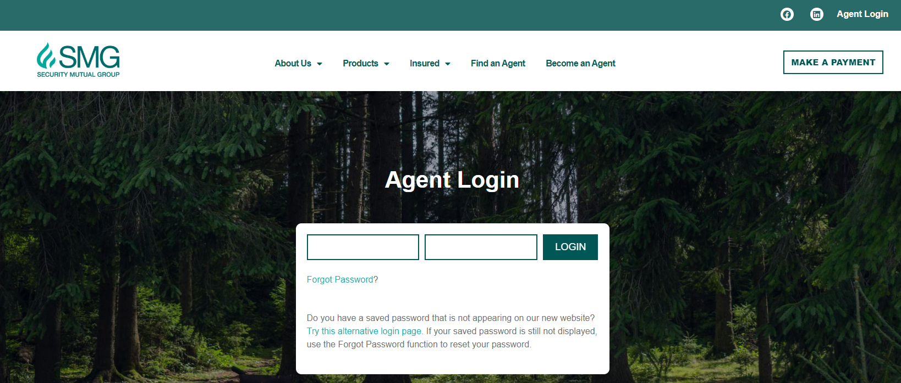
Let’s Get Started!

Slide 4
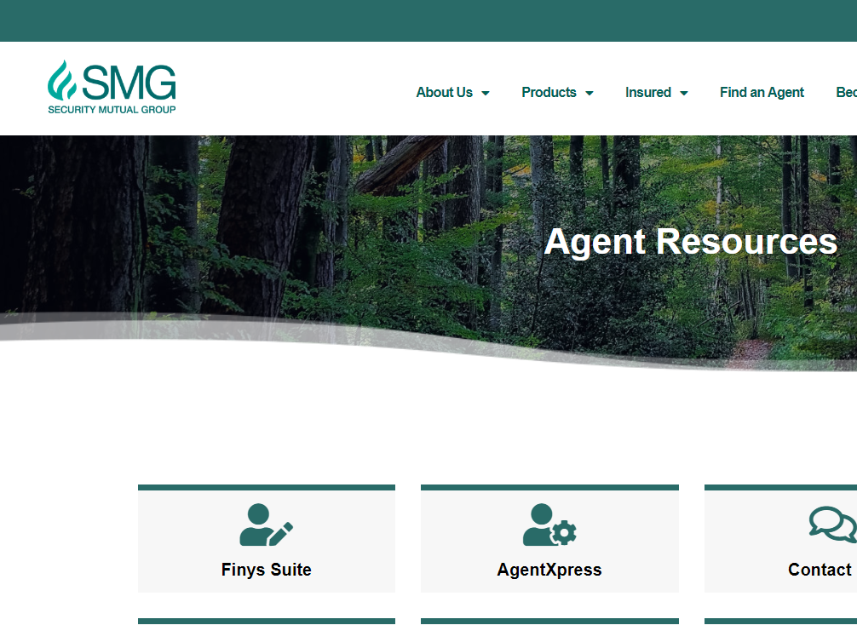
Finys Suite

Slide 5
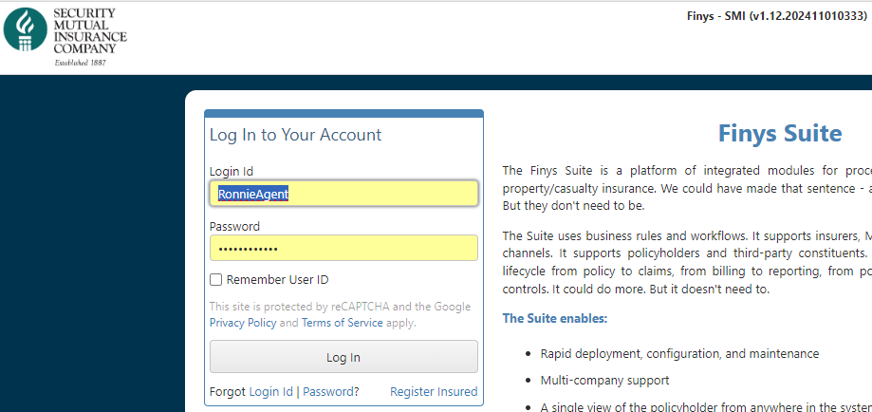
Log Into Finys
Disclaimer! UAT screens may be different from screens agents see
Need Help?
password@securitymutual.com
call your Territory Manager

Slide 6
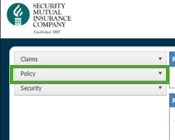
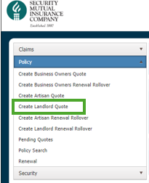
Start a Quote

Slide 7
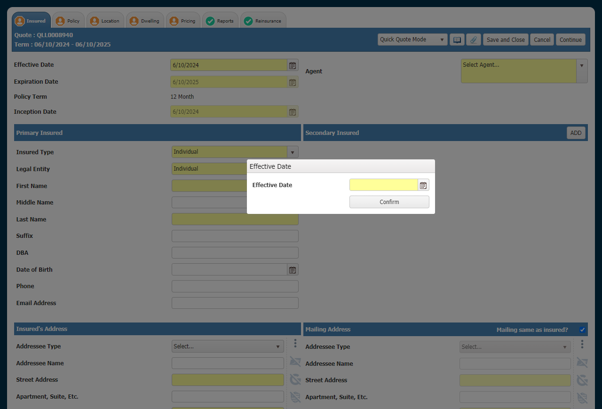
Tab Navigation
Page Actions

Slide 8
Tab Navigation
Green Checkmark: No more work is required for that screen
Red Dollar Sign: screen is missing required information, or a rule is preventing rating or application submission.
Orange Silhouette: Underwriter Referral is triggered by a rule that is related to that screen

Slide 9
Page Actions
Drop Down Menu: change from Quick Quote to Application Mode
Book Icon: View and Add Tasks and Notes for the Quote/Application
Paperclip: View and Attach Documents to the Quote/Application
Always Save and Close
Previous moves to the prior screen
Cancel undoes your work
Continue takes you forward one screen

Slide 10
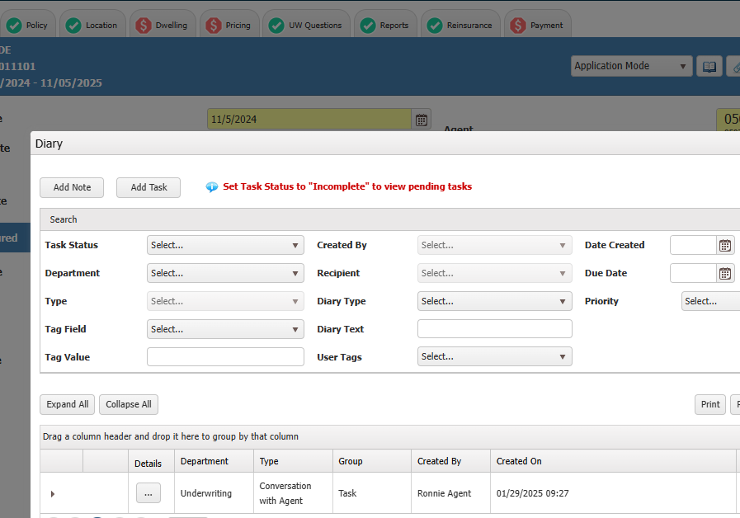
Task to Underwriting

Slide 11
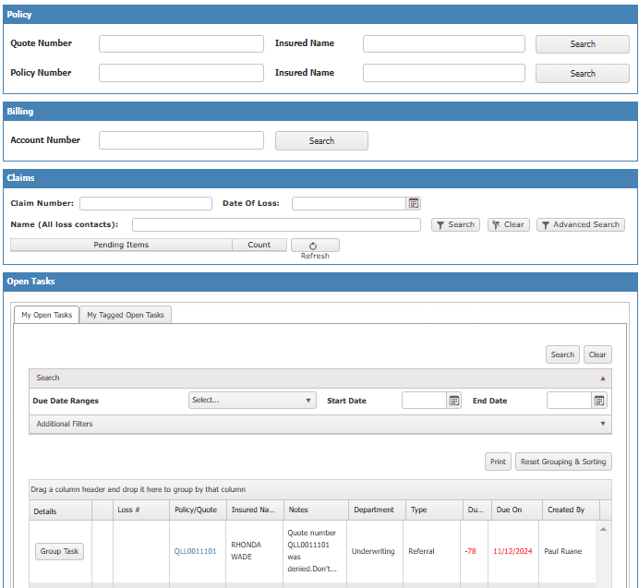
Tasks to and from Underwriters
Use the Book Icon to send tasks to underwriters. Check your dashboard for tasks from underwriters.

Slide 12
Fields
Fields in Yellow are required to proceed through the screen.
Whether or not a field is required may be dependent on whether the mode is Quote or Application.
Required fields that are not filled will have a red border if you attempt to navigate from the page.

Slide 13
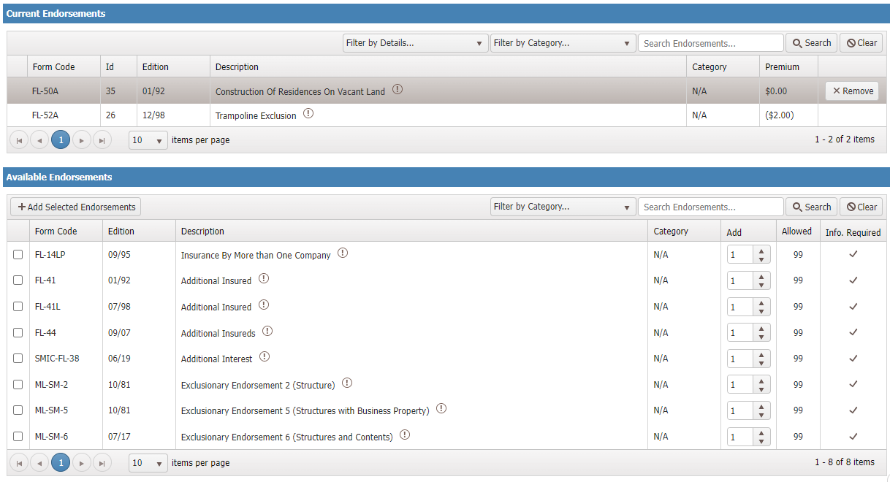
Endorsements
PDF of form

Slide 14
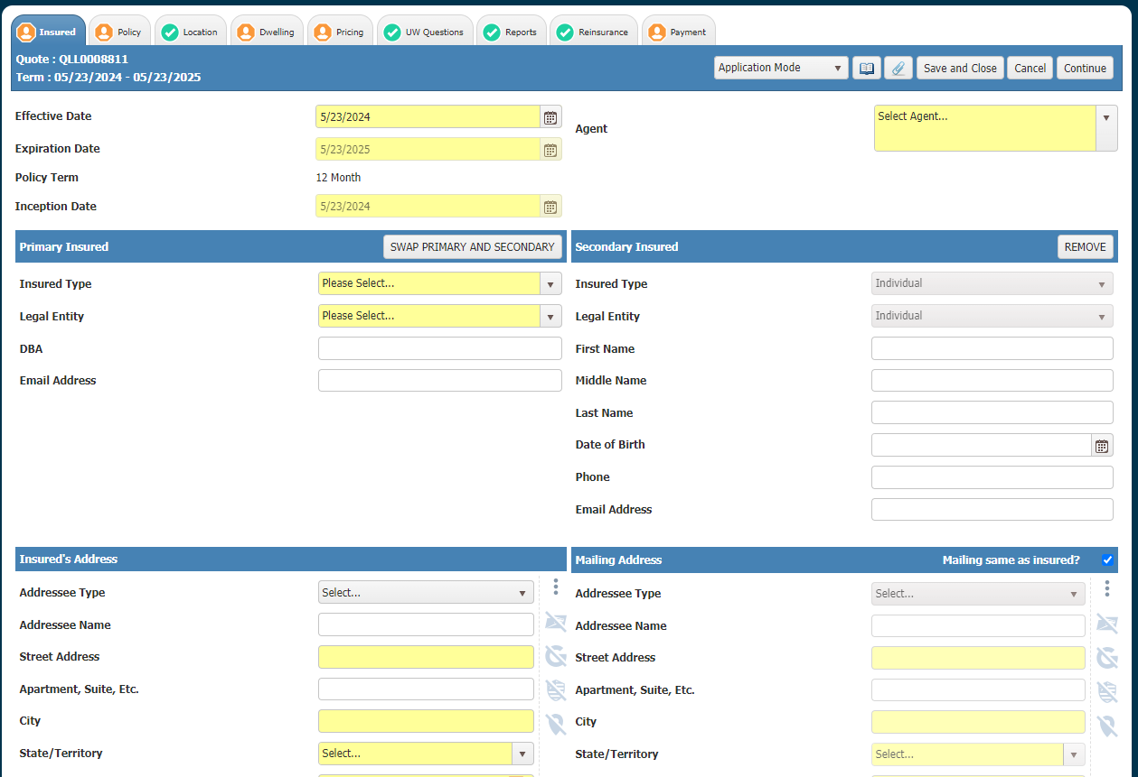
Let’s Quote! Insured Tab
Knock Out if any are answered yes
“N” Tab

Slide 15
Insured Tab
SCIC for all but NYC
1st location

Slide 16
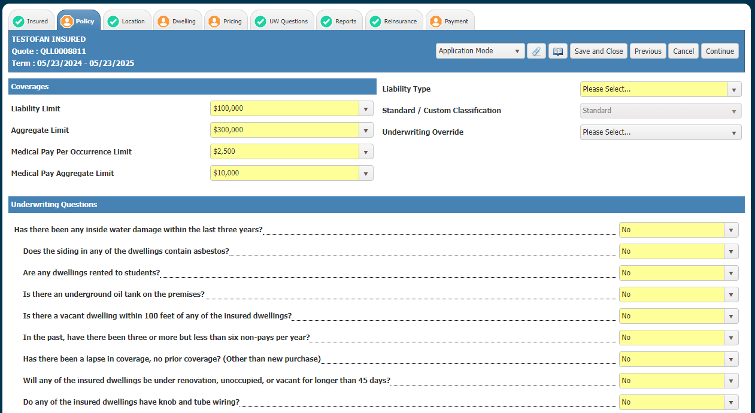
Policy Tab
Knock Down to Custom if any are answered yes, “N” Tab

Slide 17
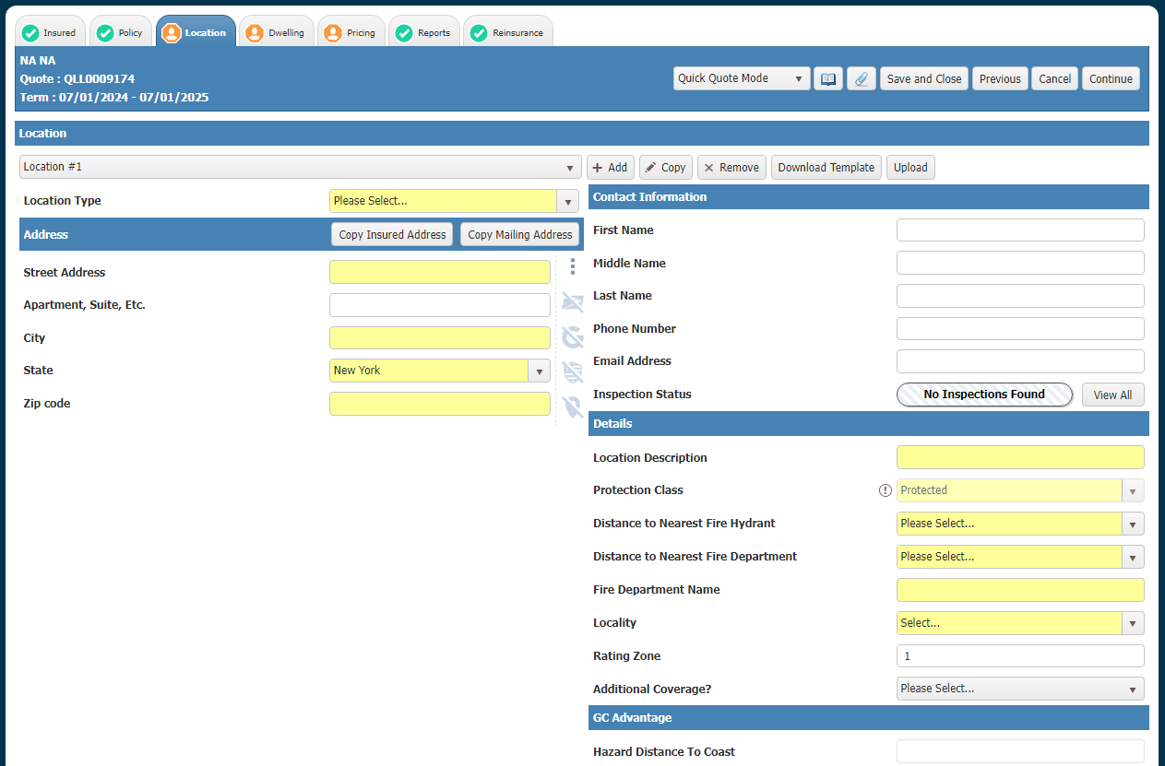
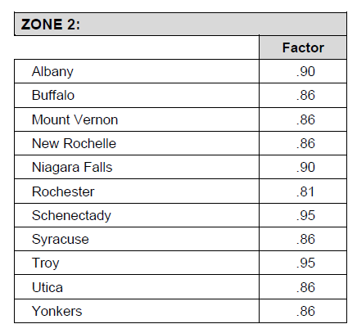
Location Tab
Copy 1st location
Add UNLIMITED locations if payor is the same AND questions on Insured and Policy tabs are “No”, otherwise, start a new CUSTOM quote

Slide 18
Location Tab

Slide 19
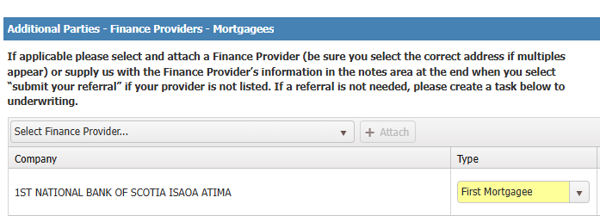
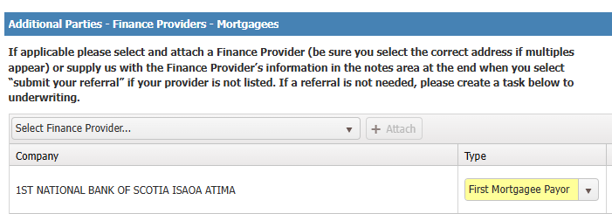
Location Tab

Slide 20
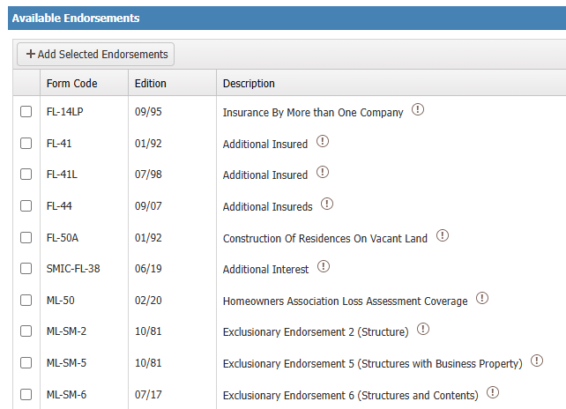
Location Tab
Property Manager

Slide 21
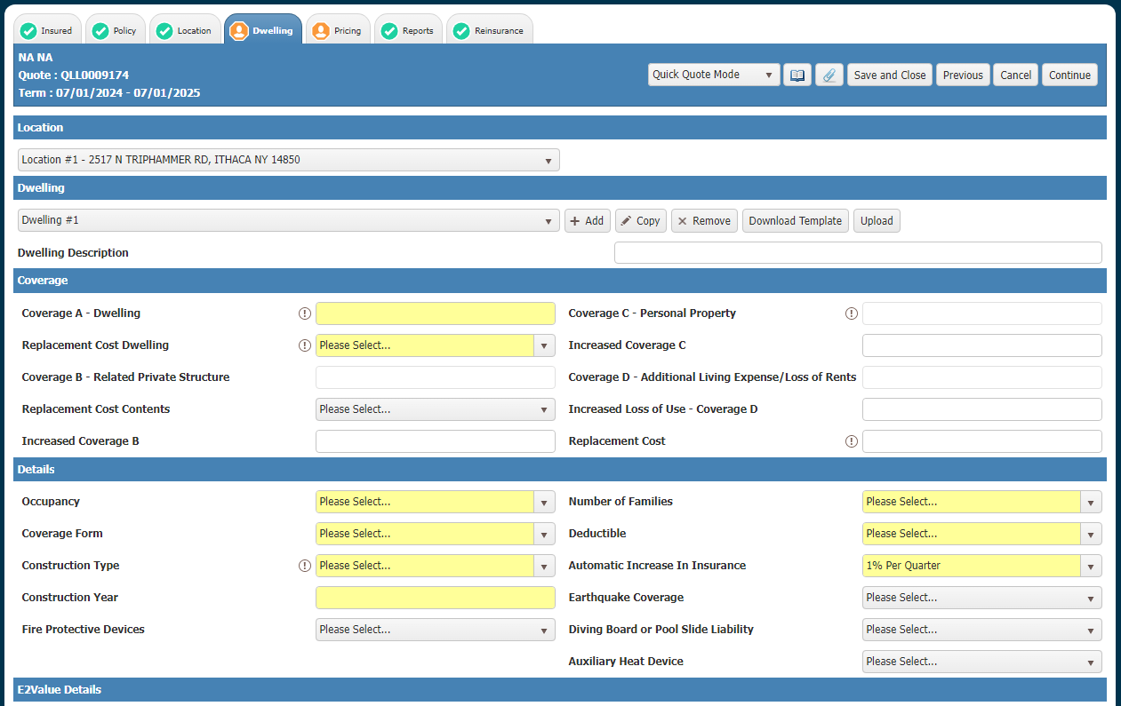
Dwelling Tab
Unlimited Dwellings
Different forms, valuations, deductibles, endorsements ..
e2Value
Enter or amend

Slide 22
Valuations
If Market Value < 33% of RC:
Actual Cash Valuation – minimum limits
($20,000 CUSTOM, $75,000 STANDARD)
Comparable Value ACV + ML-16 (50% of RC)
If Market value is at least 33% of RC:
FL-33 Functional Replacement Cost – provide estimate of different building
Replacement Cost - like kind, quality, square footage, features, 80% of RC, 100% with FL-360

Slide 23
RC Disclaimer

Slide 24
Dwelling Tab
Coverage Form and Valuation are unrelated
Coverage Form is determined by answers to UW Questions:
Broadest coverage in Zone 2, FL-2B with ACV

Slide 25
Dwelling Tab
8% credit
The only Plumbing Type that would reduce the rating from "Since" to "Prior" on its own is Galvanized. Since rates are 10% lower than prior rates.
Construction Year (Greater Than or Equal to 1960 = Since)
Electrical Year Renovation (Less Than 20 Years from Effective Date = Since)
Heating Year Renovation (Less Than 20 Years from Effective Date = Since)
Roof Year Renovation (Less Than 20 Years from Effective Date = Since)
Plumbing Year Renovation (Less Than 20 Years from Effective Date = Since)
Plumbing Type (Galvanized = Prior)
Electrical Type (Fuses = Prior)

Slide 26
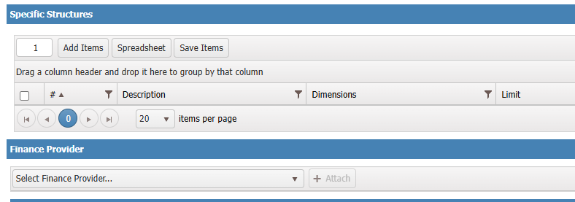
Dwelling Tab
Rather than Increased Coverage B

Slide 27
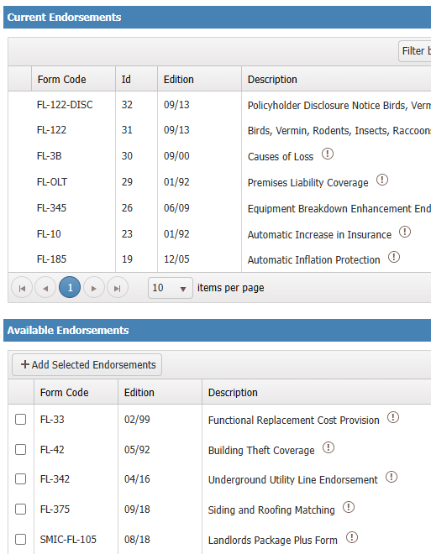
Dwelling Tab
New
FL-72
Back-up of Sewers and Drains
$20,000 Max. replaces $5,000 in SMIC-FL-105

Slide 28
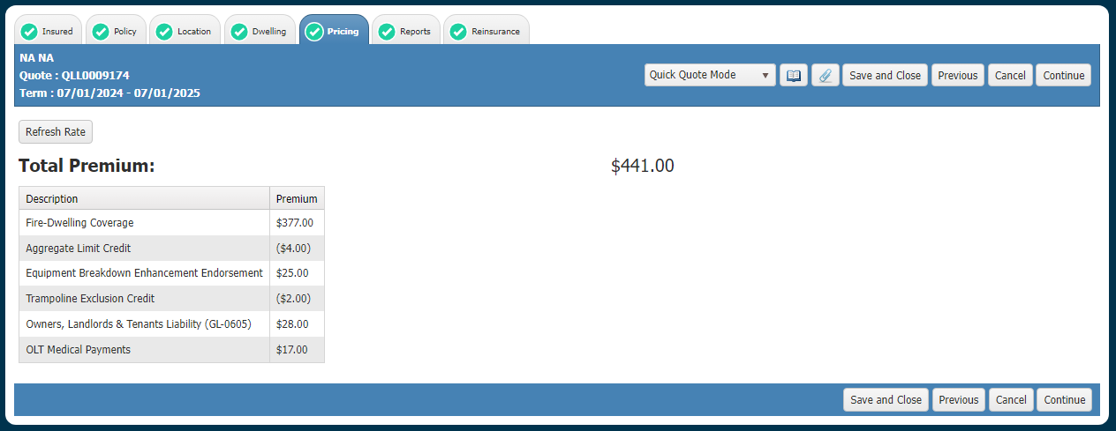
Pricing

Slide 29
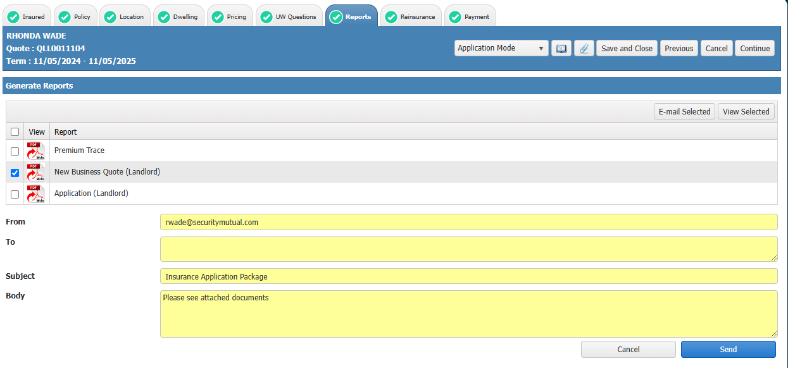
Reports

Slide 30
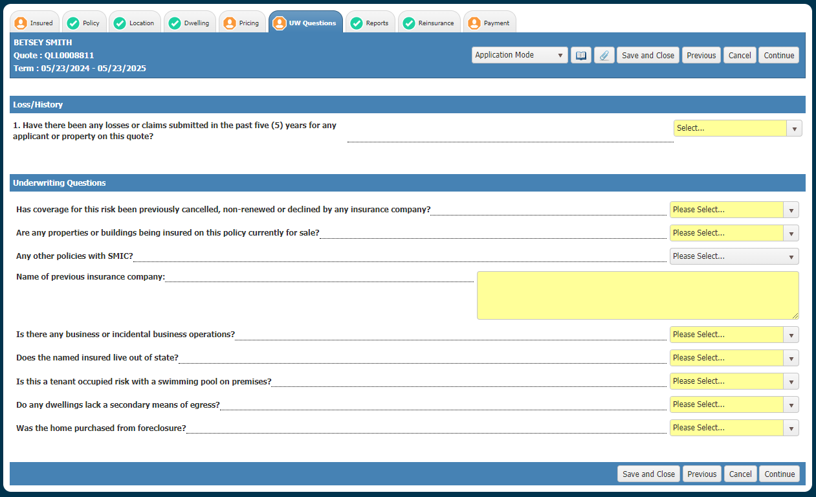
Application Mode-UW Questions

Slide 31
Reports
Send email to insured for signature, keep signed copy at the agency

Slide 32
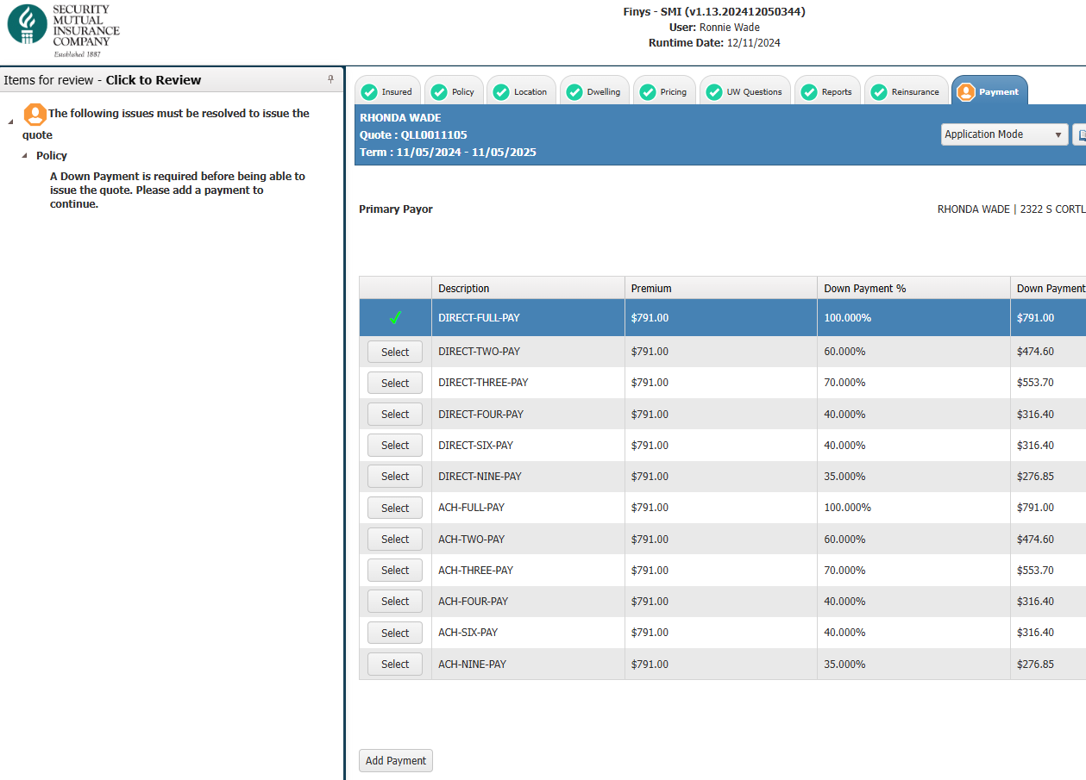
Payment

Slide 33
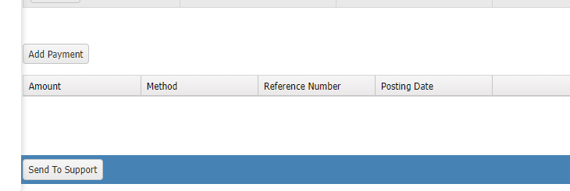
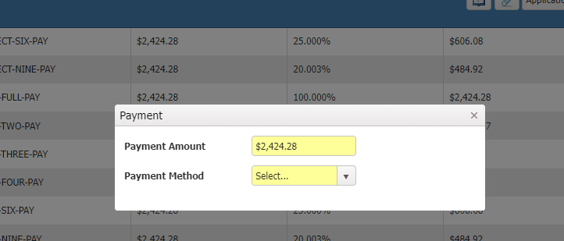
Payment
Required to submit application

Slide 34
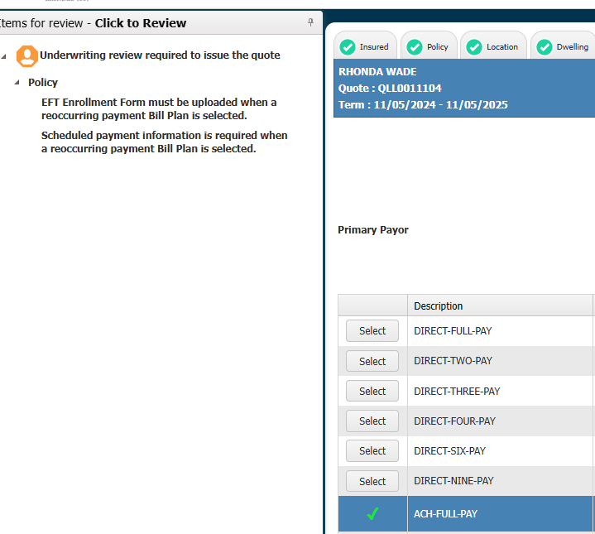
Payment

Slide 35
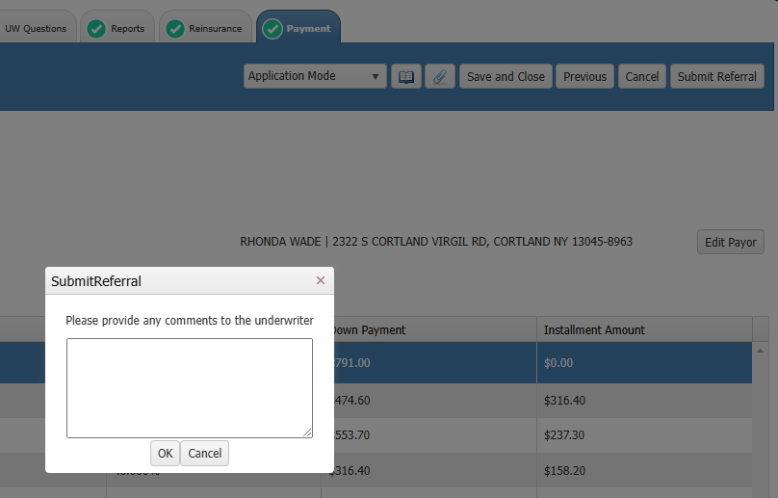
Submit Referral

Slide 36
Questions?
underwriting@securitymutual.com
Wendy ext 5552 wflansburg@securitymutual.com
Karen ext 5475 ktaber@securitymutual.com
MaryEllen ext 5268 mbrown@securitymutual.com
Ronnie ext 5458 rwade@securitymutual.com
Send us a teams or zoom invite and share your screen – let’s do this!

