Slide 1
Writing Dwelling Fire Policies with FINYS

Slide 2
When to use Dwelling Fire?
Primary, seasonal, secondary homes not eligible for wind coverage, or Coverage A is too high, no theft coverage
Mobile Homeowners rented to others (single wide, double wide not on a continuous masonry foundation)
Rental properties not eligible for wind coverage
Seasonal rental properties (closed for one season)
Related private structure coverage only
Multiple seasonal/secondary residences owned by family members
Builders Risks greater than six months
Dwellings Under Construction
Under renovation > 45 days
House flippers
Barns with or without hay

Slide 3
Quotes Applications

Slide 4
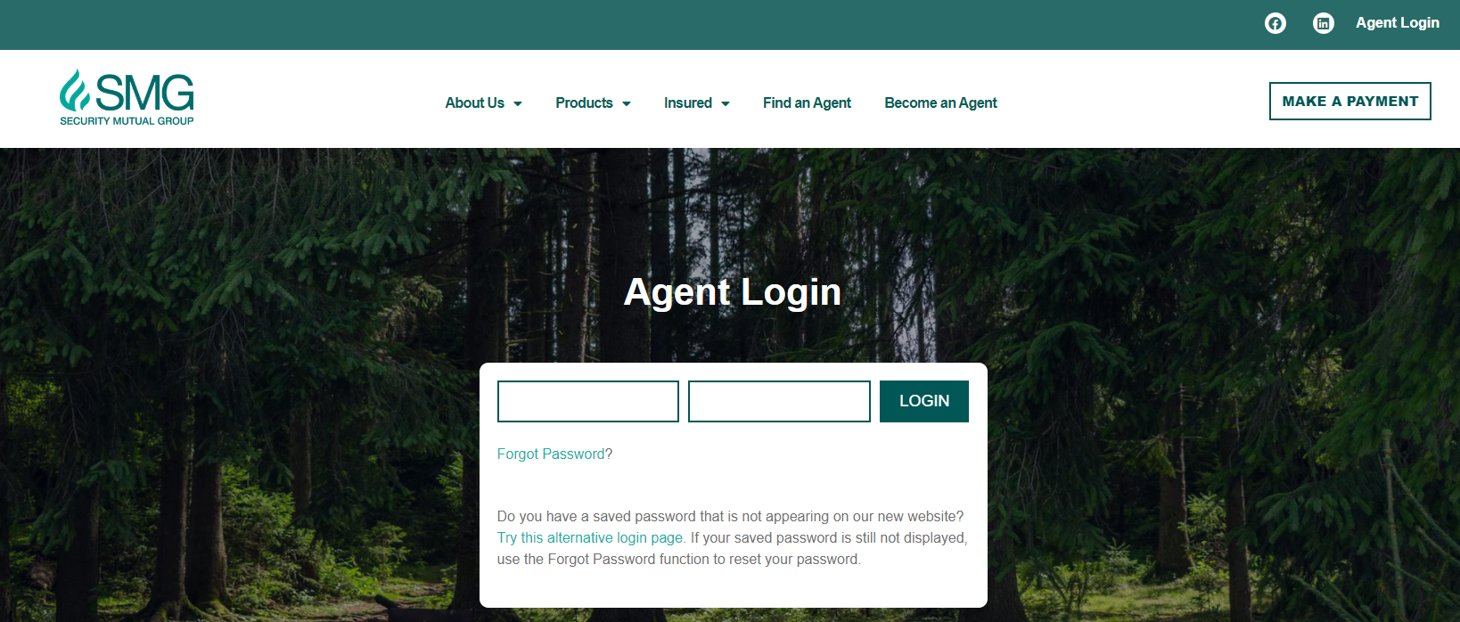
Let’s Get Started!

Slide 5
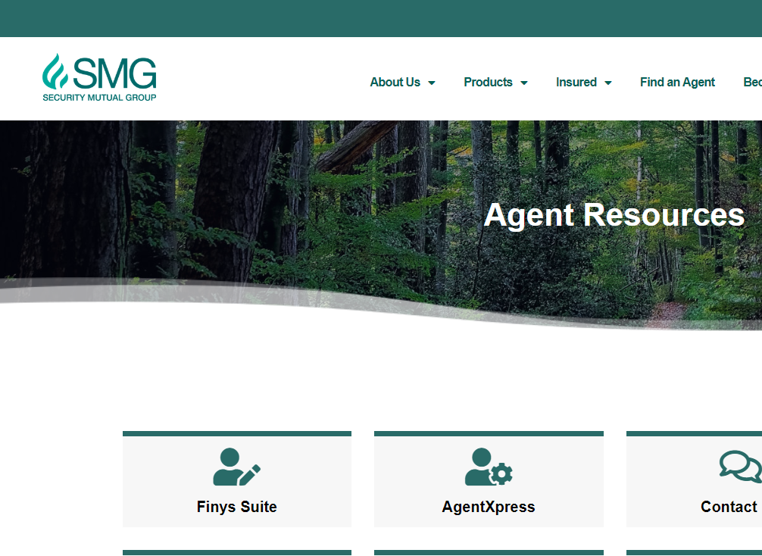
Finys Suite

Slide 6
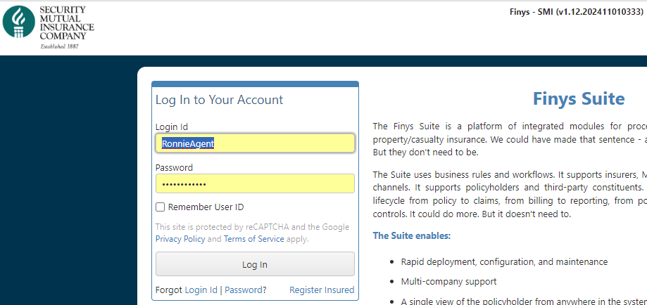
Log Into Finys
Disclaimer! UAT screens may be different from screens agents see
Need Help?
password@securitymutual.com
call your Territory Manager

Slide 7

Start a Quote

Slide 8
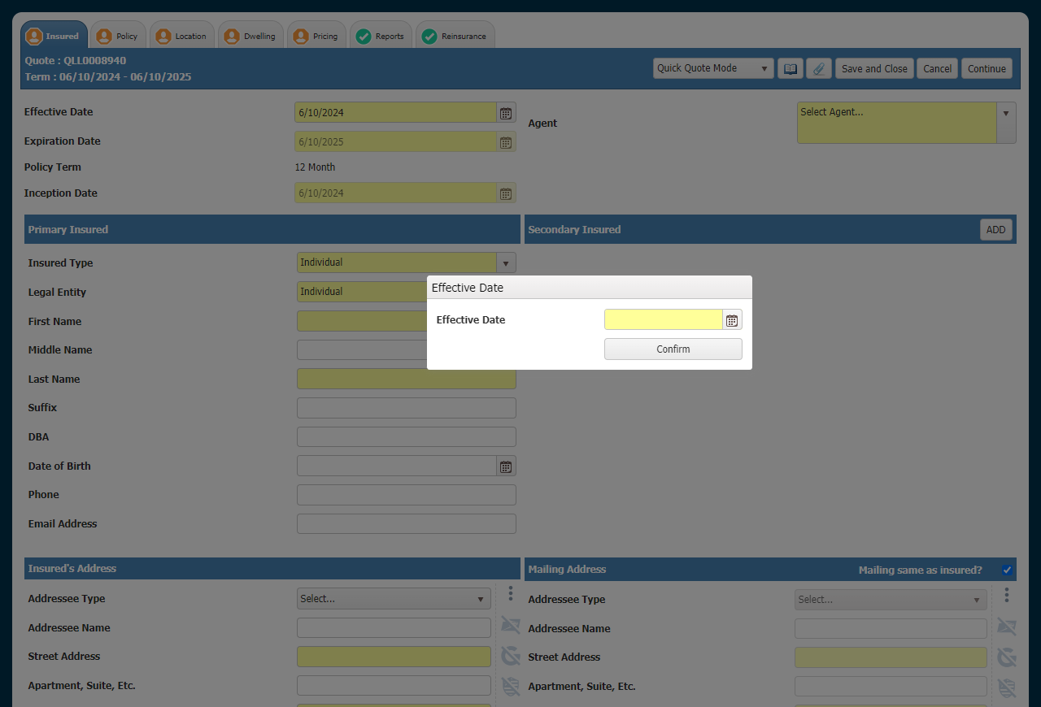
Tab Navigation
Page Actions

Slide 9

Tab Navigation
Green Checkmark: No more work is required for that screen
Red Dollar Sign: screen is missing required information, or a rule is preventing rating or application submission.
Orange Silhouette: Underwriter Referral is triggered by a rule that is related to that screen

Slide 10

Page Actions
Drop Down Menu: change from Quick Quote Mode to Application Mode
Document: View and Attach Documents to the Quote/Application
Diary: View and Add Tasks and Notes for the Quote/Application
Previous moves to the prior screen
Delete Quote: undoes your work
Always Save
Continue takes you forward one screen

Slide 11
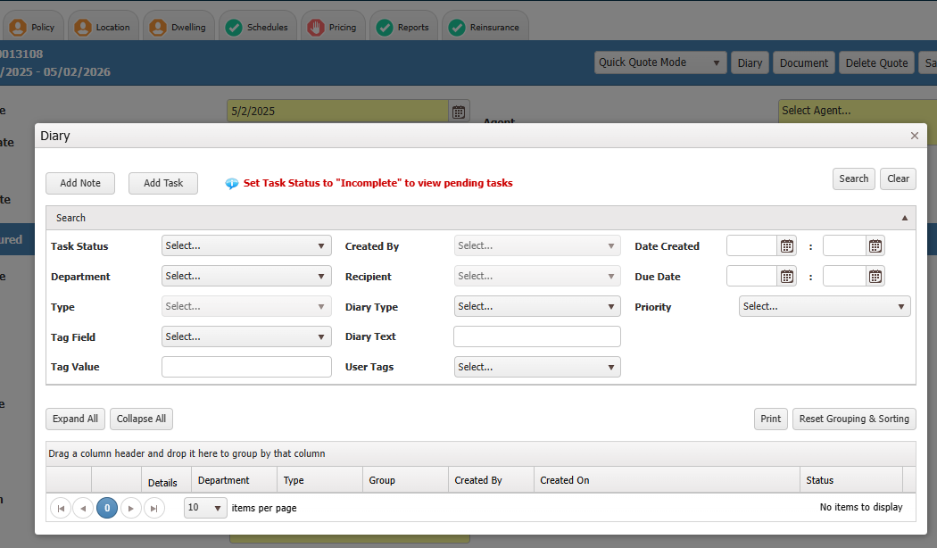
Task and Note to Underwriting

Slide 12
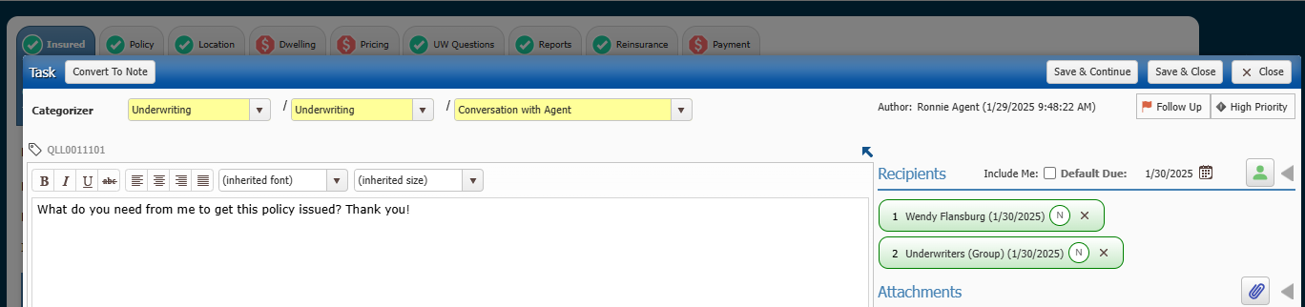
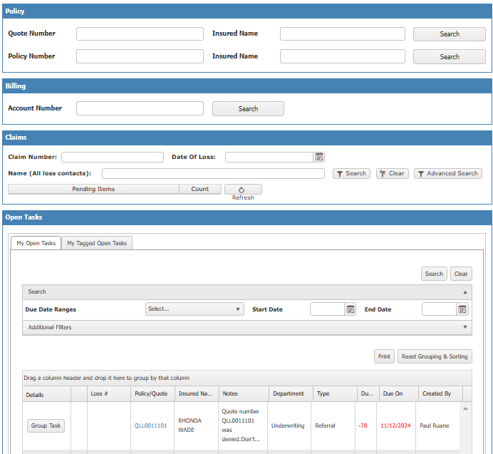
Task and Note
Use the Diary Button to send tasks and notes to underwriters.
Check your dashboard for tasks from underwriters.
SCROLL DOWN DAILY

Slide 13
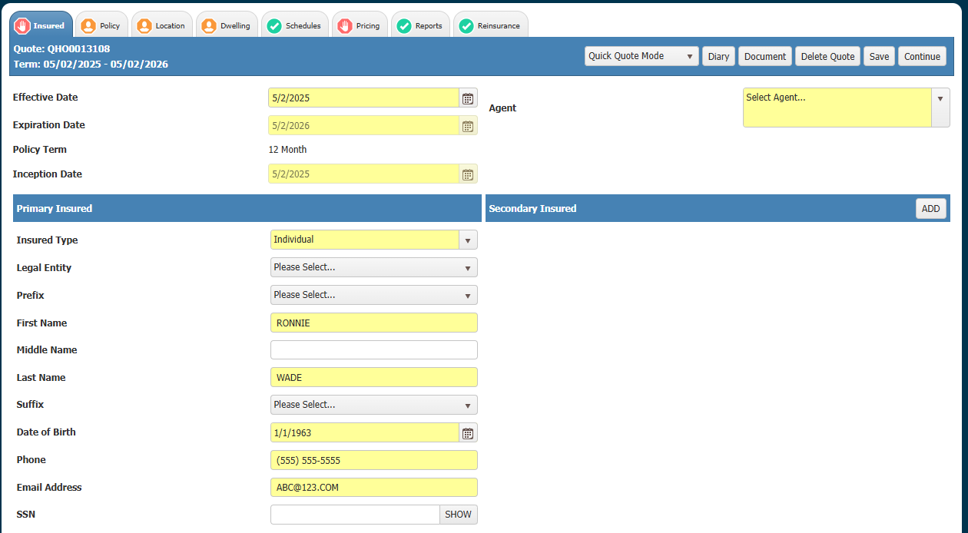
Document Button

Slide 14
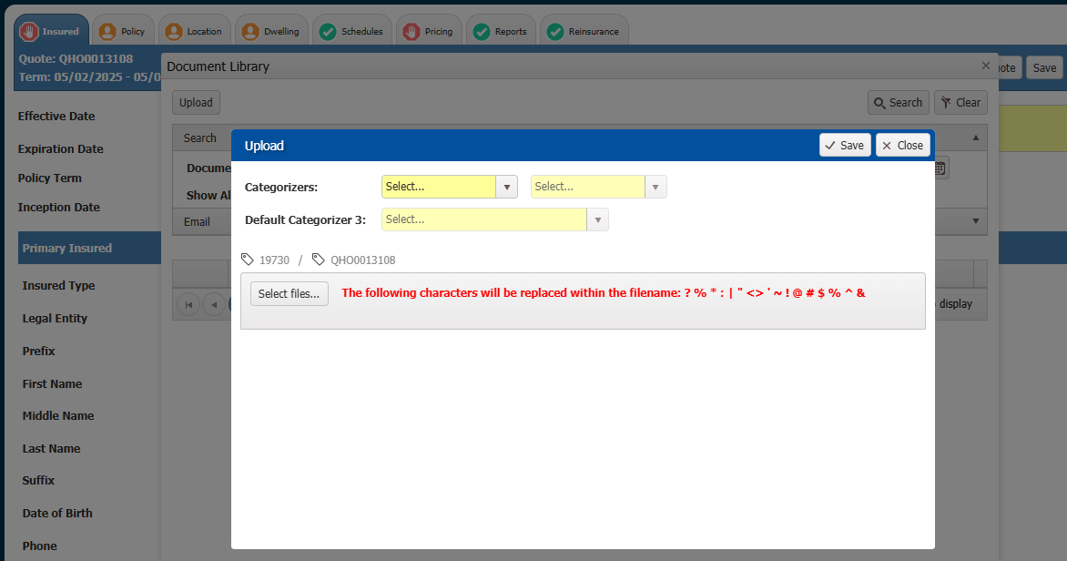
Document Button
Billing, Billing, EFT, for autopay form
Underwriting, Underwriting, Picture/Report,
for estimator, photos…

Slide 15
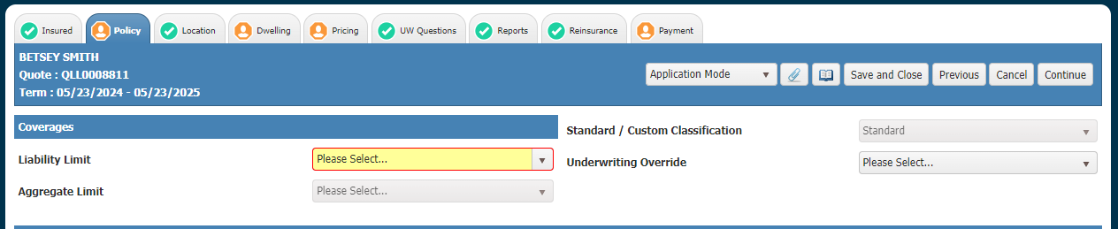
Fields
Fields in Yellow are required to proceed through the screen.
Whether or not a field is required may be dependent on whether the mode is Quote or Application.
Required fields that are not filled will have a red border if you attempt to navigate from the page.

Slide 16
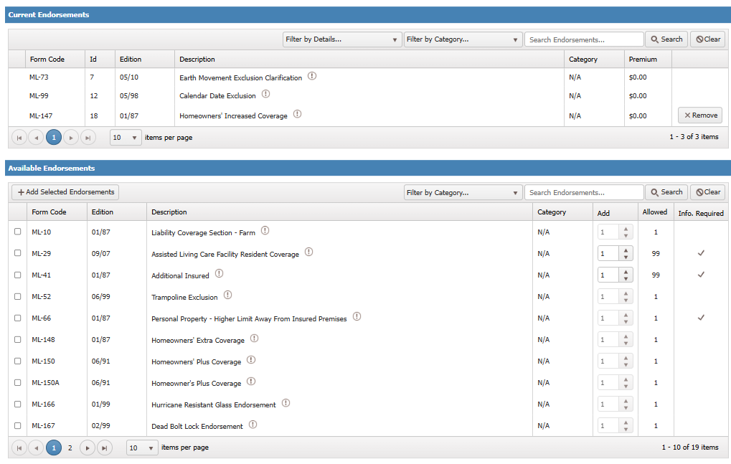
Endorsements
PDF of form
Expand to see all

Slide 17
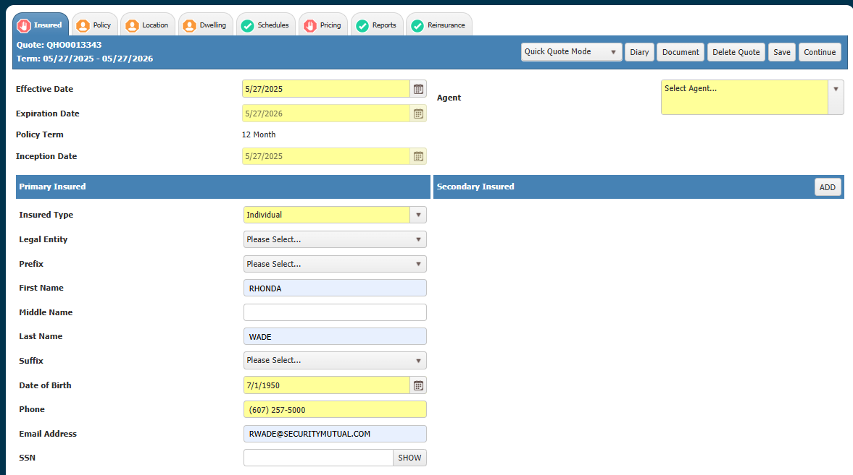
Let’s quote! Insured Tab
Physical location

Slide 18
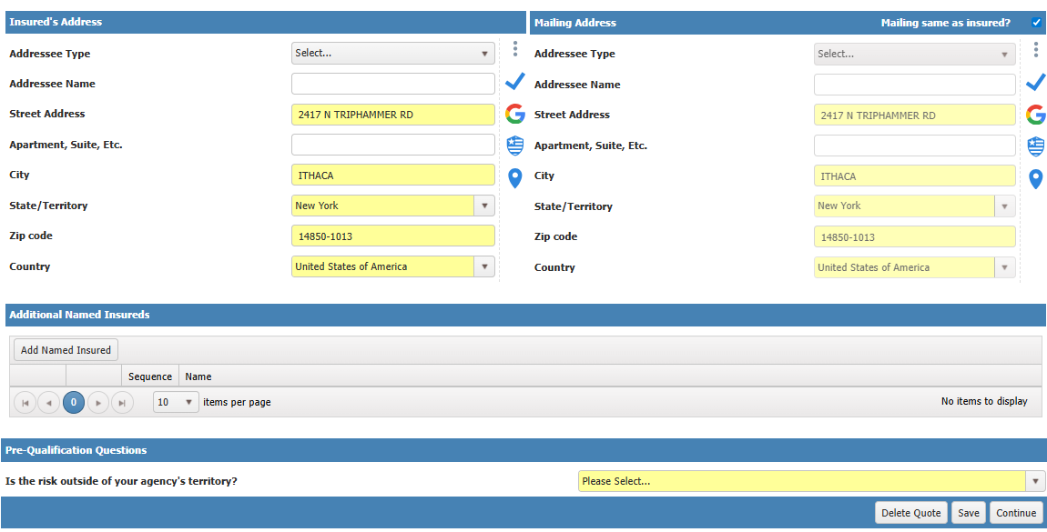
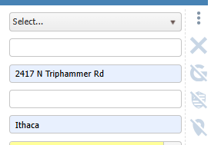
Insured Tab
If you cannot physically inspect the risk, then this would be out of your territory.

Slide 19
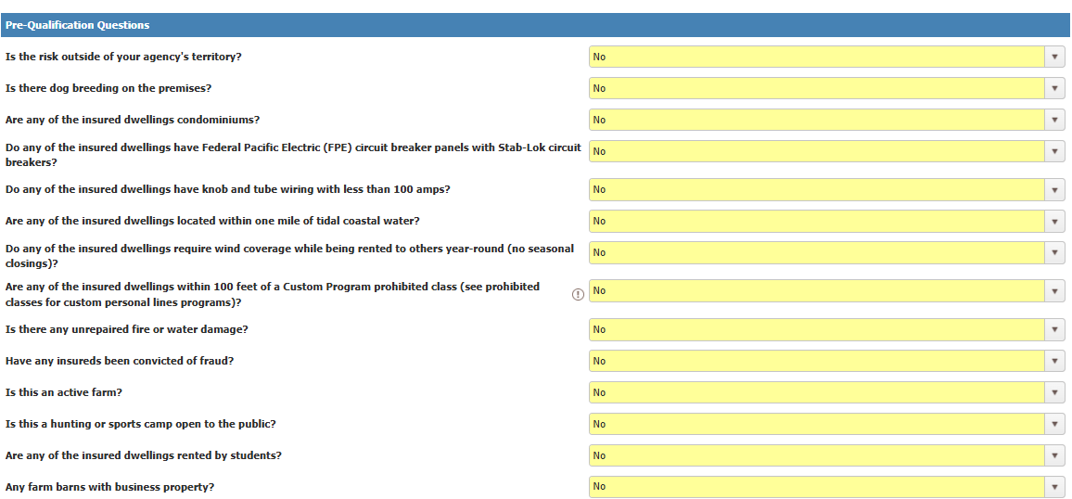
Insured Tab – knock out of Dwelling Fire
Landlord

Slide 20
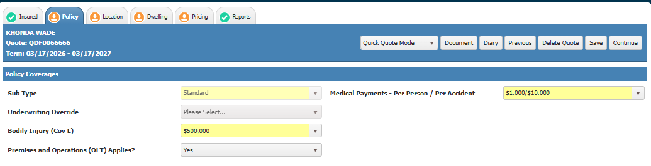
Policy Tab – Liability
No for CPL
CPL is available for named insureds if all named insureds are living in the same unit and it is a primary home.

Slide 21
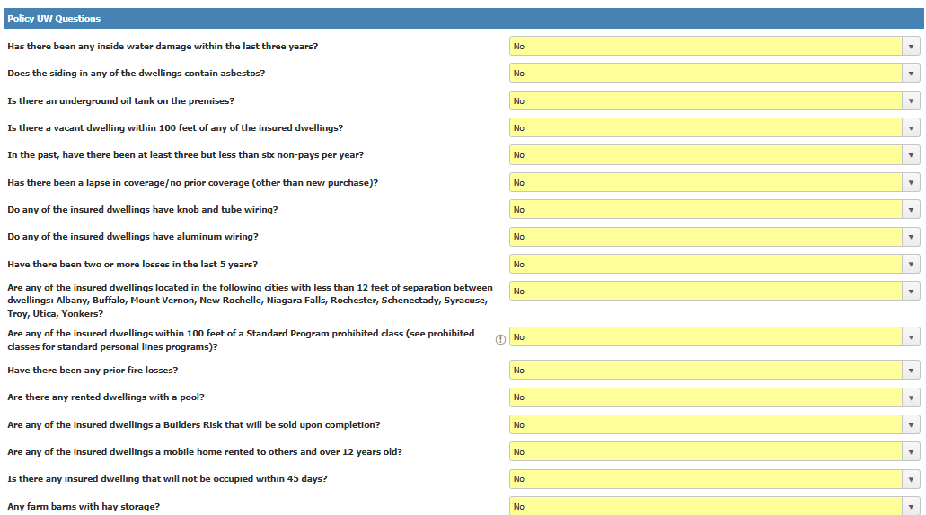
Policy Tab – Knock down

Slide 22
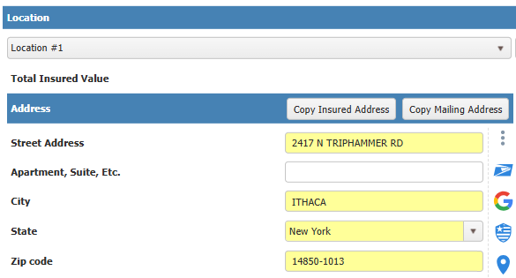
Location Tab
One location per policy

Slide 23
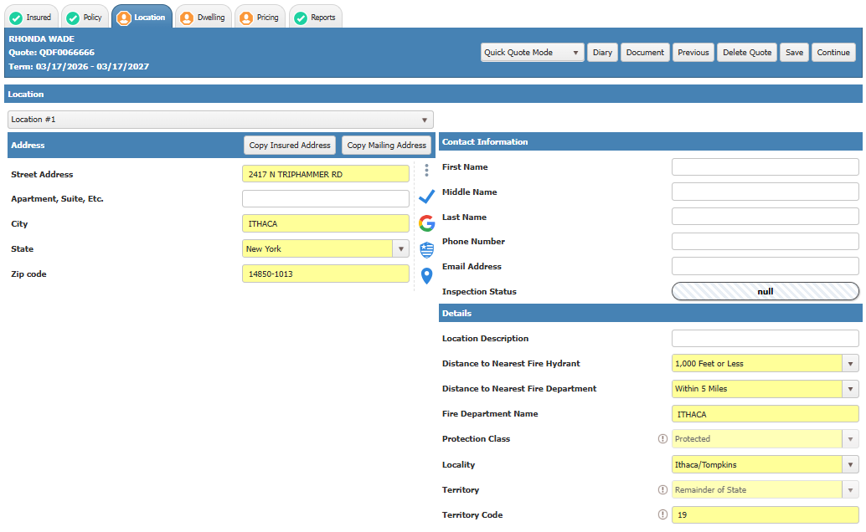
Location Tab

Slide 24
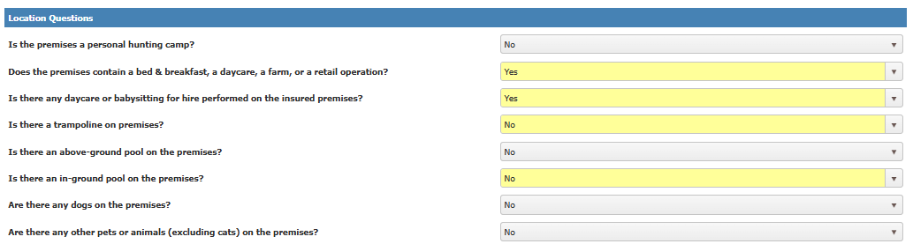
Location Tab
No more separate questionnaires, Yes answers will expand

Slide 25
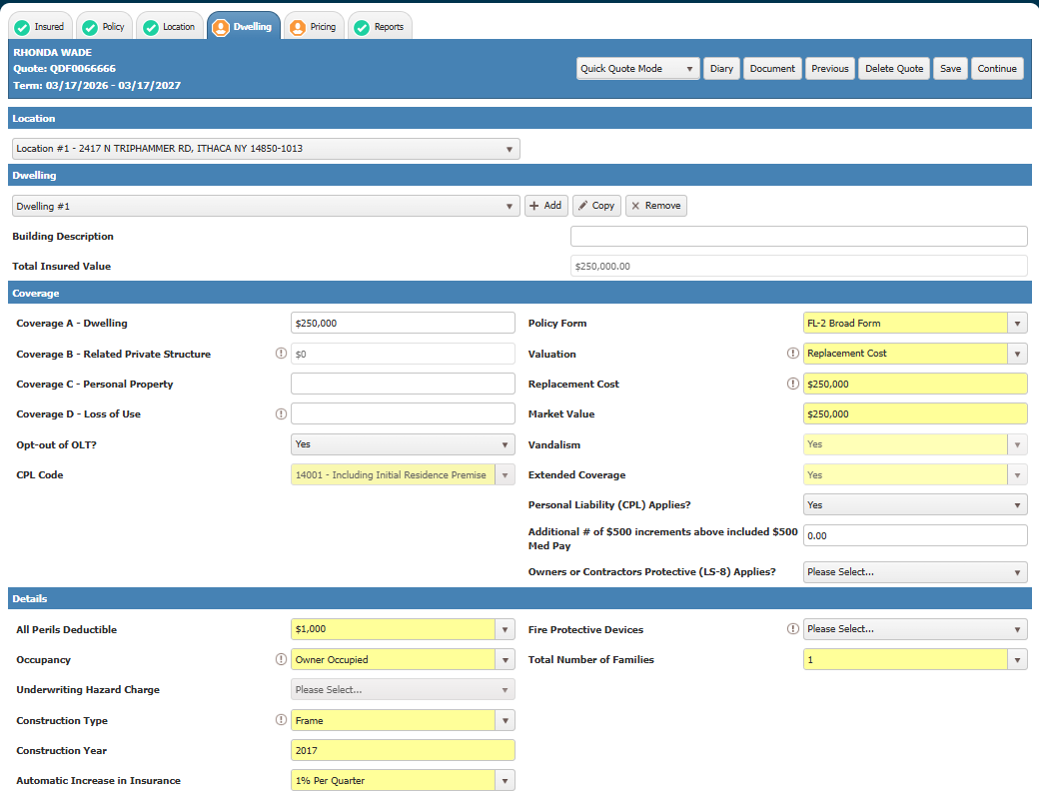
Dwelling Tab
Occupancy:
Owner
Tenant – no wind
Builders Risk (CV)
Seasonal
Seasonal Rental –
closed for a season
Unoccupied
(under renovation)
Vacant
Under Construction

Slide 26
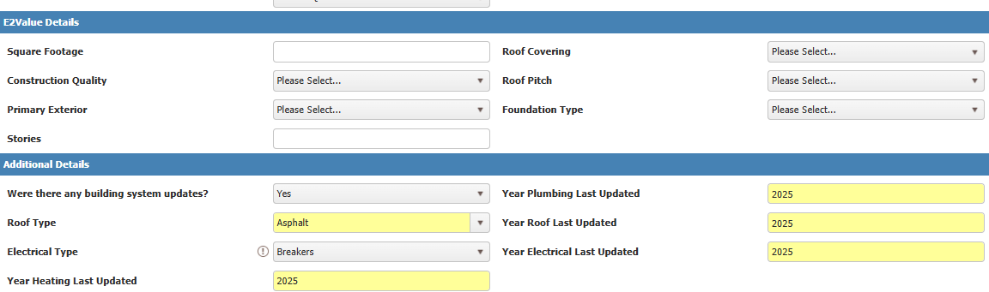
Dwelling Tab

Slide 27
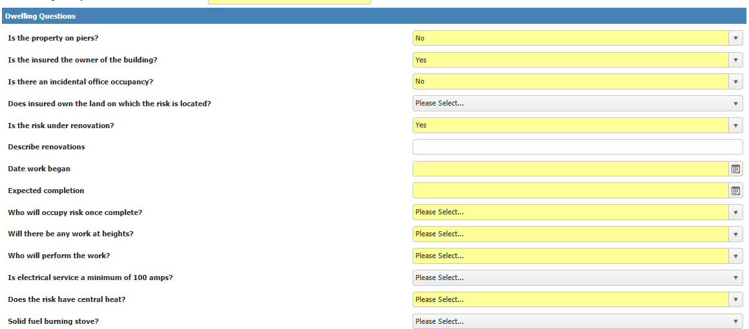
Dwelling Tab - Custom

Slide 28
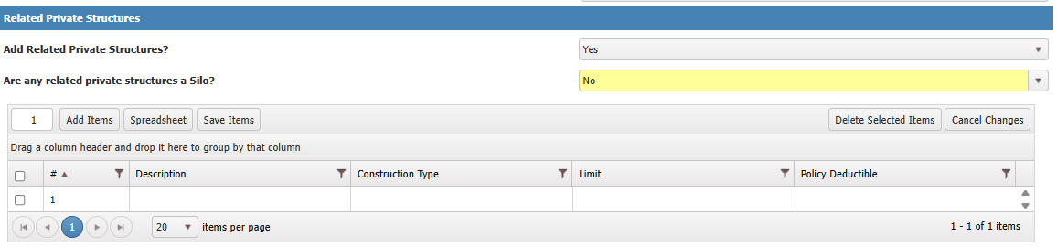
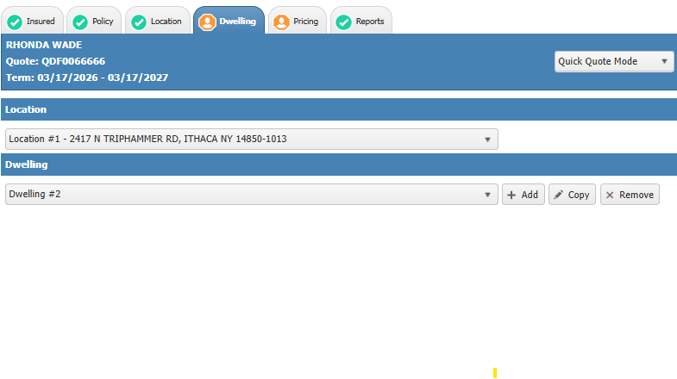
Dwelling Tab – Related Private Structures
After Dwelling Questions
One related private structure per dwelling even if there is no residence

Slide 29
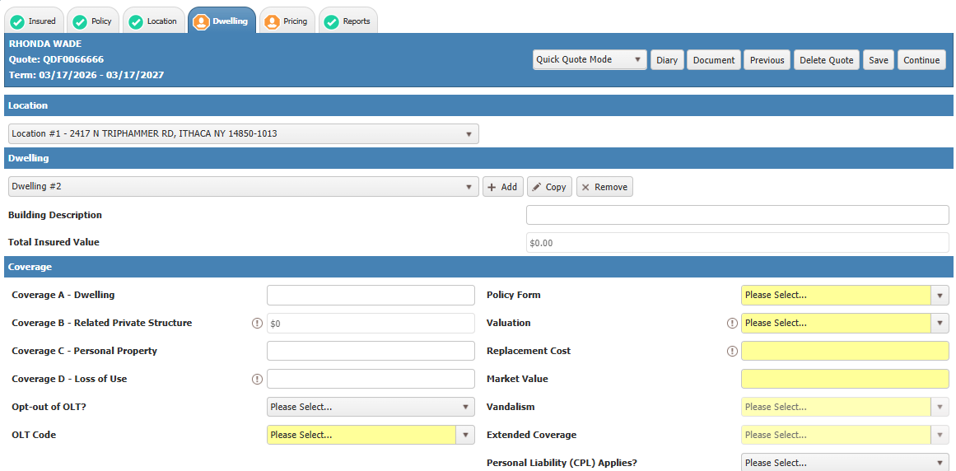
Dwelling Tab – Multiple buildings OLT
When to opt out of OLT?
Same exposure, used by same family unit, opt-out of related buildings
Different family units, different tenants, occupancies, no opt-out

Slide 30
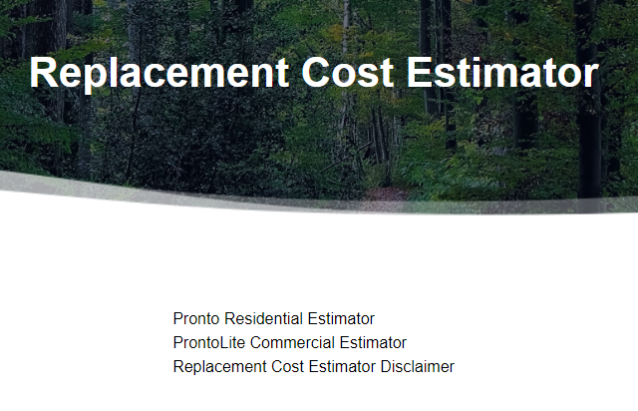
RC Disclaimer
Upload a replacement cost estimator through the document button if you use other than e2Value
Not required for builders risks, replacement cost = completed value

Slide 31
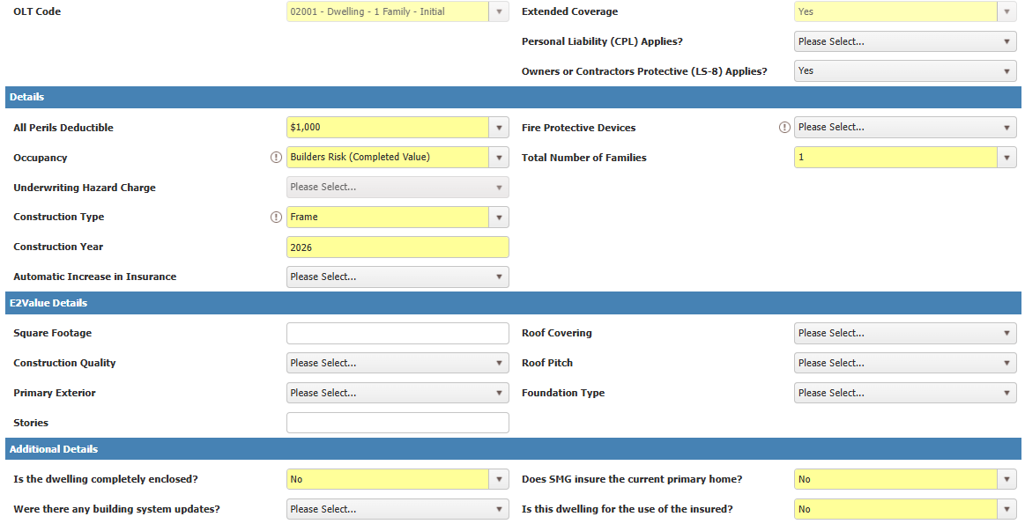
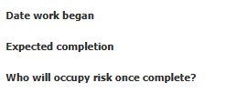
Builders Risk
Custom: Sold upon completion
Standard: Occupied upon completion and written with us

Slide 32
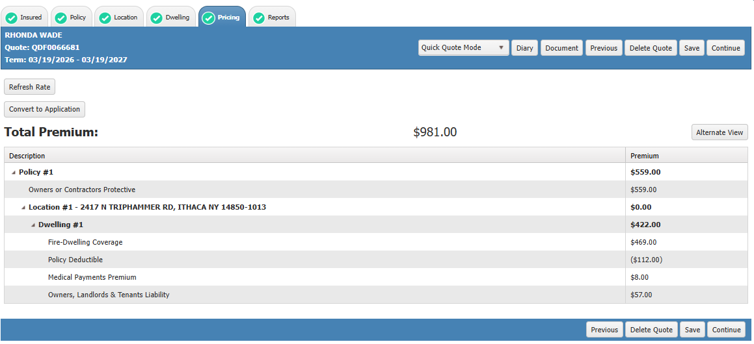
Pricing

Slide 33
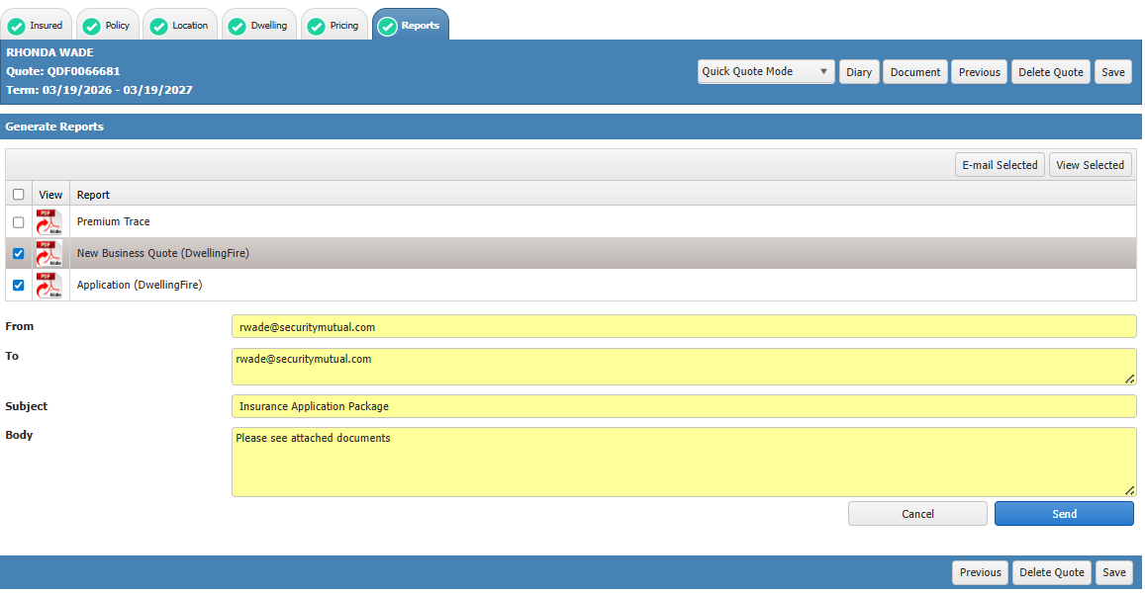
Reports – Quote, Application

Slide 34
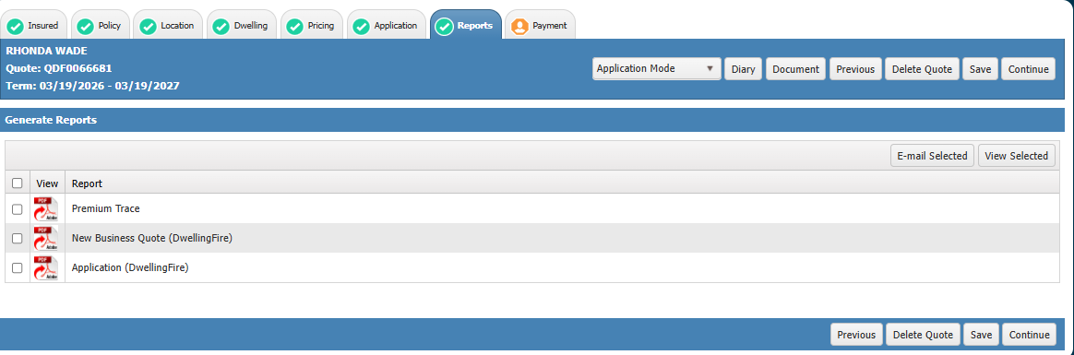
Reports – application mode
Send email to insured for signature, keep signed copy at the agency

Slide 35
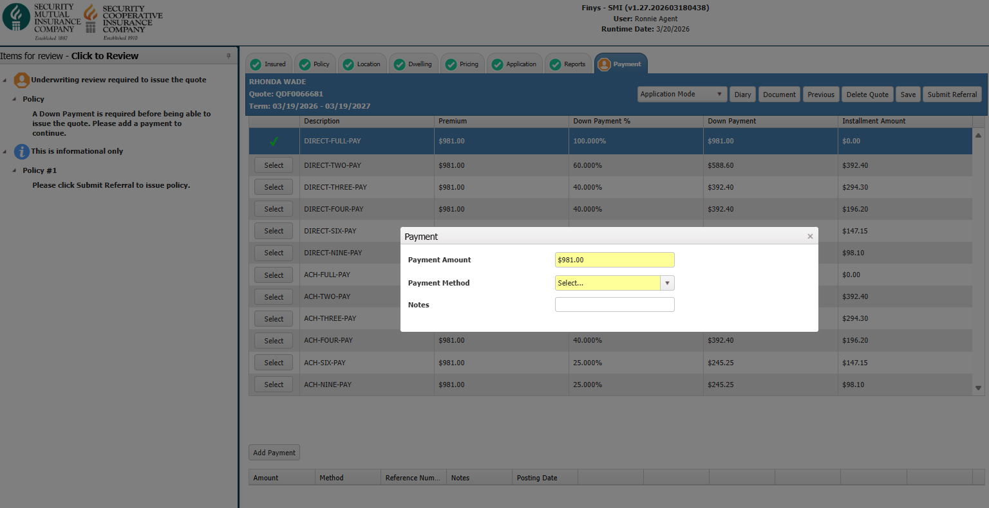
Payment

Slide 36
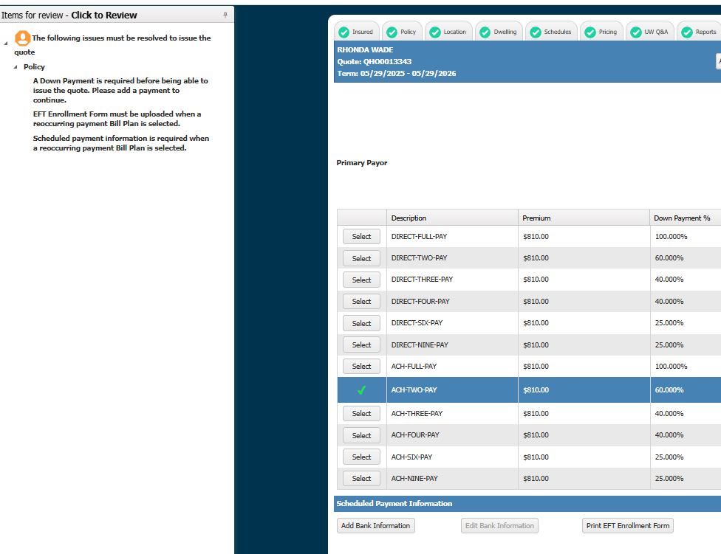
ACH Payment

Slide 37
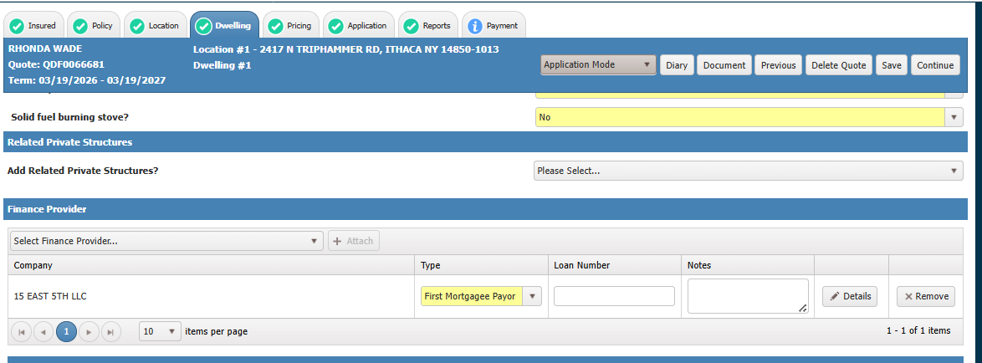
Mortgagee Bill

Slide 38
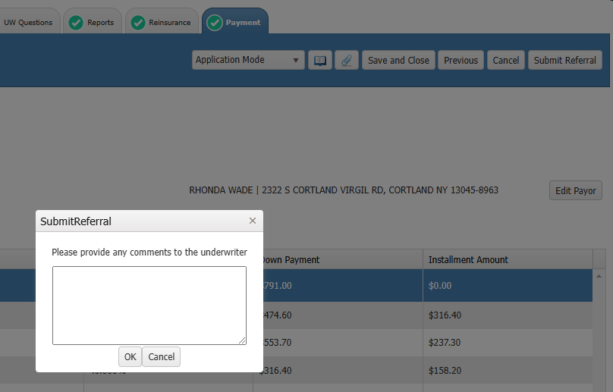
Submit Referral

Slide 39

Policy Number Prefixes
10 for Dwelling Fire
Followed by Company (all will be 1/SMIC)
Followed by 1 for Standard, 2 for Custom
Followed by Personal 0
All policies are in sequence regardless of program: provide last five digits for assistance

Slide 40
New Business Underwriters
underwriting@securitymutual.com
Karen ext 5475 ktaber@securitymutual.com
Wendy ext 5552 wflansburg@securitymutual.com
MaryEllen ext 5268 mbrown@securitymutual.com
Ronnie ext 5458 rwade@securitymutual.com
Send us a teams or zoom invite and share your screen – let’s do this!

Slide 41
Questions?
Steve Crobar / Marketing Director
Amanda Reisman / Eastern New York
Courtney Best / Adirondack Region
Jamie Murphy / Western New York
Roger Miller / Central New York

